Slide 1



https://github.com/xxLestadxx/FabricPresentation2019Feb
Yordan Gospodinov
Notes:
Fabric - blockchain framework
Composer - blockchain business model and concept creator

Slide 2
Permissioned blockchain - better for businesses
Introducing roles to different participants
Mostly the consensus is Byzantine fault-tolerant using the PBFT protocol [1] that among the n validating peers at most f < n/3 may “lie” and behave arbitrarily, but all others execute the chaincode correctly.
Pluggable, modular structure with main components :
Certificate authority - deciding the roles of the participants
Consensus and ordering system
Chaincode (smart contracts)

Slide 3
Confidential transactions
In a network of different companies, confidential business transaction enable competitiveness
No cryptocurrency
Faster transactions at no cost
More transactions per given time
Programmable
Have smart contracts called chaincode, to program the business logic
Notes:
This will enable the businesses to keep confidential the information they want

Slide 4
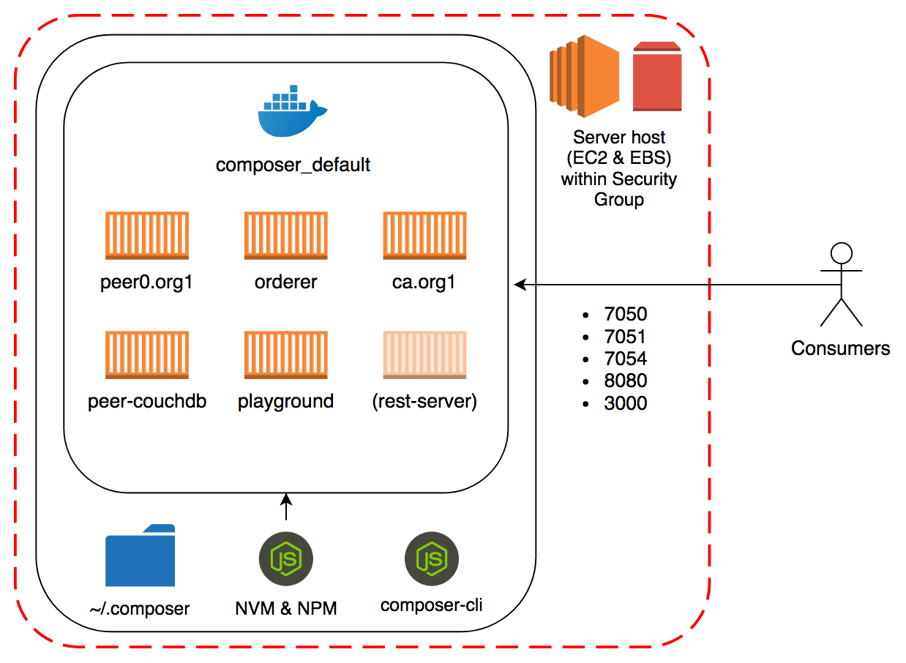
https://blog.codecentric.de/en/2018/08/fabric-test-network-ansible-aws/

Slide 5
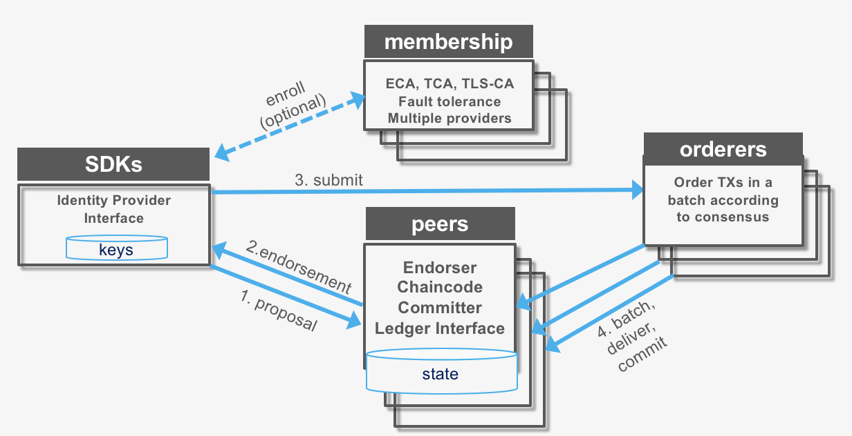
Fabric transaction flow

Slide 6
It was aiming for creating blockchain agnostic business networks (with primary implementing on Fabric)
Easy to use
Provides REST (Representational State Transfer) API
Creating business network out of 3 main files :
Model file
Logic file (JS)
Permissions file
It has Query files as well if needed

Slide 7
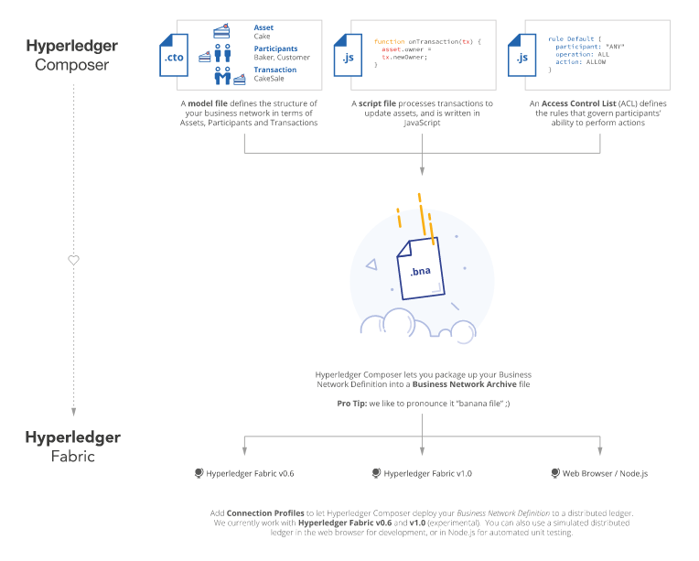
Composer to Fabric flow

Slide 8
VS Code
IDE( Integrated Development Environment ) / Text editor
Has plugins for Hyperledger Composer and Docker
Makes your life easier while developing a business network and then examining and inspecting different Fabric components.

Slide 9
Hyperledger online Composer playground
https://composer-playground.mybluemix.net/editor
Easy to use and to test out your business concept and model
THE BUSINESS NETWORK MAY BEHAVE DIFFERENTLY WHEN IMPLEMENTED ON FABRIC

Slide 10
Some working systems built with Fabric
TradeLens - company founded by collaborative work of Maersk and IBM. The idea is to make the shipping process cost-efficient, faster and simpler. It is a system in the supply chain field.
https://www.tradelens.com/
Verify.Me - mobile app, in and for Canada, to verify your identity in different institutions and services. By using Fabric, the user is only sending pointers to the information, without the respective institutions or services to have the user’s data.
https://verified.me
Walmart is working with IBM for supply chain for their products
https://techcrunch.com/2018/09/24/walmart-is-betting-on-the-blockchain-to-improve-food-safety/

Slide 11
Resources
Hyperledger Composer documentation
https://hyperledger.github.io/composer/v0.19/introduction/introduction.html
Hyperledger Fabric documentation
https://hyperledger-fabric.readthedocs.io/en/latest/
Blockchain development with HPL Fabric and composer course on udemy
https://www.udemy.com/hyperledger/
The rocket chat from Hyperledger organisation, responsive at any time
https://chat.hyperledger.org/
Enterprise blockchain development: with Hyperledger Fabric and Composer by Ernesto Lee, it will be available in the (Uni of Stirling) library after 17.04.2019

Slide 12
References
[1] Architecture of the Hyperledger Blockchain Fabric, Christian Cachin, IBM Research - Zurich, 2016

